Slide 1
Development of a Handheld OCT Probe for Guiding 25 Gauge Vitrectomy
Calvin Yoon
February 02, 2014

Slide 2
Abstract
Optical coherence tomography (OCT) endoscopic probes have been developed to monitor the posterior pole during vitrectomy. We have designed a 25-gauge (0.5mm diameter) backward-scanning GRIN lens-based OCT probe integrated with an illumination system. The probe was used to image microspheres and ex vivo tissue samples of the pig eye. This opens possibilities for the development of a simpler endoscopic system for improved sutureless vitrectomy. (64 words)

Slide 3
Abstract
Wavelength-swept source (SSOCT-1310, Axsun)
10X scanning objective lens (LSM02, Thorlabs)
10X GRIN lens, 1 pitch relay lens, 31.5 mm (GRINTECH)
2D Galvo scanner (GVS102, Thorlabs)
Scanning rate: 50 kHz (A-line)
Signal-to-noise ratio: 64 dB
Image size: 500 pixels across (754 um FOV)
Lateral resolution: 7 um
Axial resolution: 7.8 um
Current setup is not optimal for quality imaging

Slide 4
Introduction
Vitrectomy is a surgery in which the vitreous is cleared from the eye so that either debris can be removed or the posterior pole can be operated on to restore vision.
Three ports enter the eye: vitreous cutter (cuts the vitreous), endoillumination probe (light source), and fluid cannula (transport of vitreous and fluid)
Especially in the case of retinal detachment, the biggest difficulty is in assessing the amount of vitreous remaining since the posterior pole has to be as “dry” as physiologically possible.
In the event that improper attachment of the retina takes place due to the influence of the remaining vitreous, surgery must occur again.

Slide 5
Introduction
Traditionally, if viewing of the vitreous is not obscured by cataracts, the surgeon views into the eye through the patient’s pupil using a wide viewing lens.
However, the assistance of imaging modalities such as optical coherence tomography (OCT) or ultrasound are used to better visualize the vitreous or placement of retina.
To our knowledge, usage of imaging technology and conducting surgery does not occur simultaneously. Therefore, to permit as such, OCT endoscopes for vitrectomy have been developing.

Slide 6
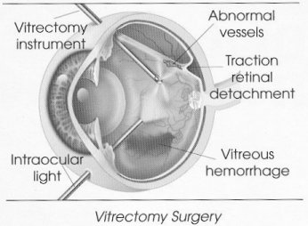
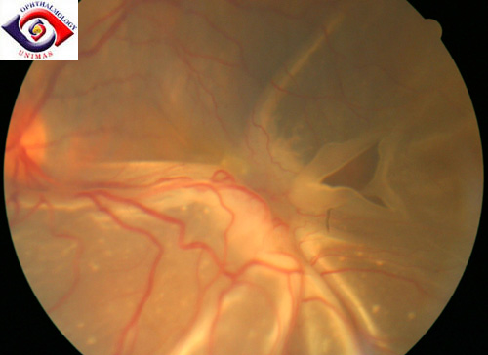
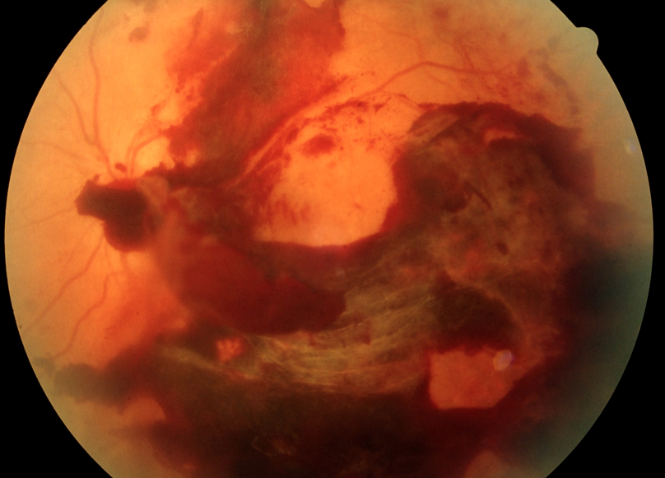
Introduction
A
B
C
Figure A: (A) Illustration of emergencies treated by vitrectomy. (B) Example of retinal detachment. (C) Example of vitreous hemorrhage.

Slide 7
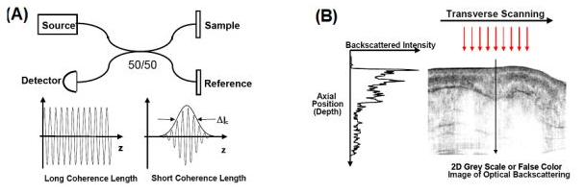
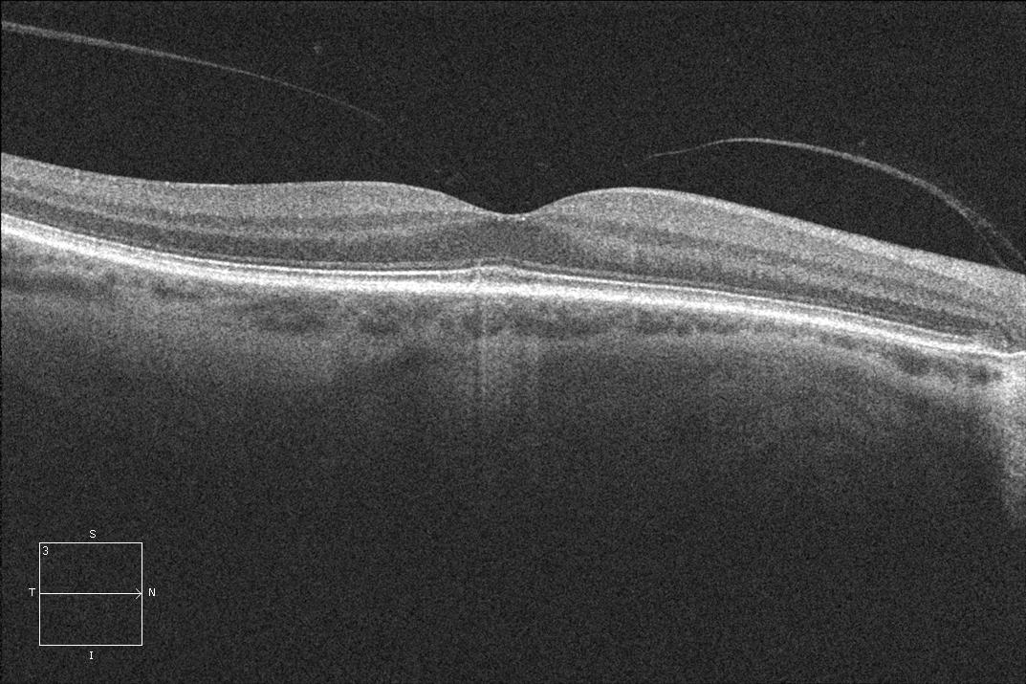
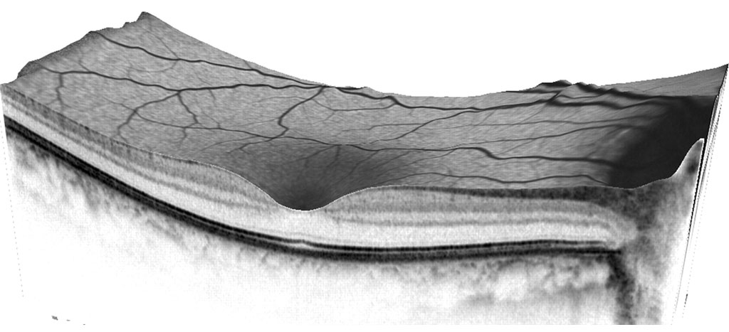
Introduction
D
Figure B: (A) OCT is based on the Michelson interferometer with a low coherence light source. (B) Measured backscattered intensity across the depth generates cross sectional images. (C) Cross section of the retina. (D) 3D image of the retina.
C
Note: OCT
Noninvasive imaging technique
Uses infrared absorption and reflective properties of material for 3D imaging
Widely used in the clinic for diagnosing and monitoring diseases of the posterior pole
Signal detection based on low coherence interferometry

Slide 8
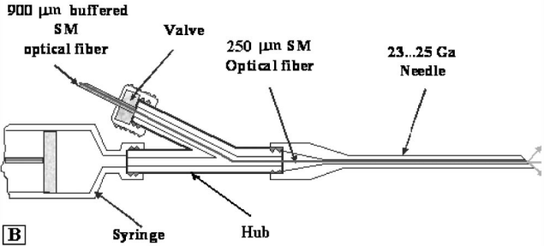
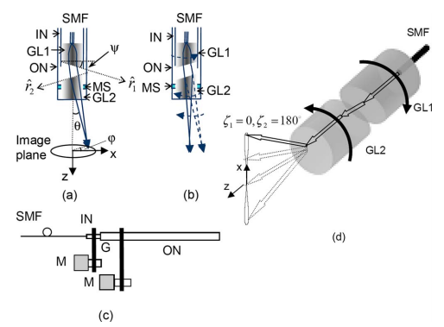
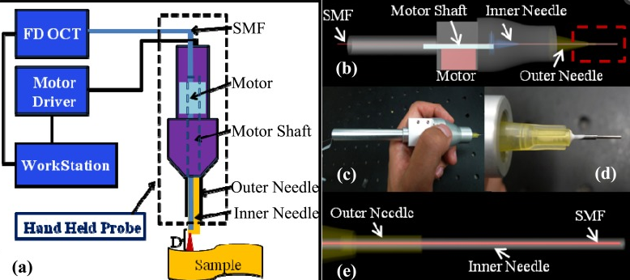
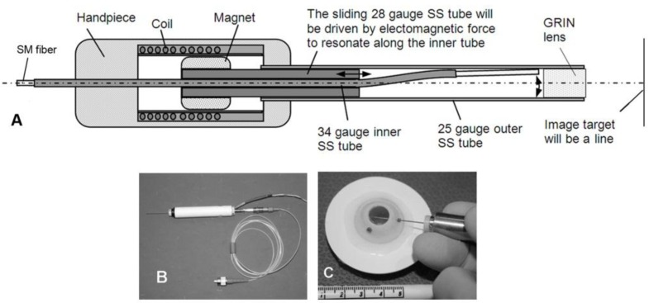
Introduction
Iftimia et al. (2005)
Wu et al. (2006)
Huang et al. (2012)
Joos et al. (2013)
Note: Miniature forward scanning probes require complex designs of piezoelectric motors. Limitations of each system collectively include: manual scanning, large diameter, and slow scanning rate.

Slide 9
Introduction
We have proposed to develop a 25 gauge probe that serves simultaneously as an illumination probe and a 3D imaging OCT system, with hopes of providing the surgeon with a more comfortable vitrectomy experience as well as to increase the efficacy of surgical outcome for the patients. 25 gauge, or 0.5 mm diameter, was set as a requirement since this dimension is the current standard for obviating the need for suturing.
In addition, currently proposed models of vitrectomy endoscopes only serve as a cross-sectional imaging modality. They achieve this through forward-scanning techniques, which pose limitations such as manual scanning or the requirement of a complex design schematic involving piezoelectric motors and the movement of optical components at the needle-end of the probe.
We wanted to eliminate this need and achieve back-scanning of the gradient index (GRIN)-relay lens which will be the only optical component of the needle end of the probe.

Slide 10
Motive
Compared to the small, 0.5 mm, diameter of the GRIN lens, we wanted to achieve a relatively large field of view (FOV). Fortunately, the GRIN lens manufacturing group, GRINTECH, provides a 0.5 mm diameter GRIN lens with a 5 mm focal length and 10X magnification. In addition, paired with a 50 kHz scanner (used in our laboratory), we aimed to design the thinnest reported multipurpose back-scanning OCT probe capable of real-time imaging.

Slide 11
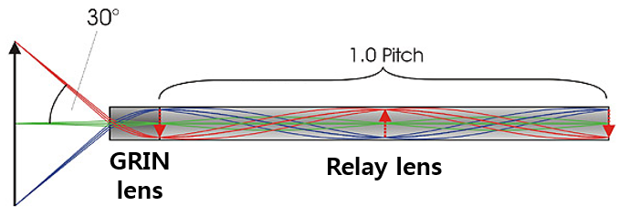
Progress
The specifications of the GRIN lens were chosen such that OCT imaging (laser convergence at the region of interest) of relatively large FOV (3-6 mm suffice) can occur inside the eye with sufficient length (lens length > 25 mm). Therefore, the GRIN lens was chosen to have a magnification of 10X, working distance of 5 mm, length of 1.19 mm for a theoretical FOV of 5.8 mm in vacuum conditions (n = 1).
In addition, the relay lens was chosen to have a length of 31.5 mm in order to satisfy the endoscope needle length and a pitch of 1 since OCT imaging occurs by the convergence of laser (Figure 1).
Figure 1: Geometry of GRIN lens. The selected GRIN lens has a diameter of 0.5 mm, working distance of 5 mm, lens length of 1.19 mm, magnification of 11.32X, and NA of 0.5. The relay lens is 31.5 mm and has a pitch of 1.

Slide 12
Progress
The collimator, lens pair, and objective lens were chosen to ensure that this system satisfied a desired lateral resolution of approximately 10 microns. Lateral resolution equals wavelength/(2*NA). 1310 nm is the center wavelength of our wavelength-swept OOCT laser source, with a bandwidth of 102 nm.
In order to achieve 10 micron resolution from the GRIN objective lens, its NA has to be approximately 0.0655, with greater values allowing finer resolution. The aforementioned GRIN lens has an NA of 0.5 (this later serves to be an issue).
The OCT scanning objective lens with a focal length of 18 mm was chosen to reduce the optical pathway as much as commercially possible. Using the equation NA = d/(2*f), the OCT scanning objective lens was calculated to have an NA of 0.083 when the beam diameter, d, is 3 mm (this also later serves to be an issue).
The axial resolution, which equals 0.44*(wavelength^2) / bandwidth, can be calculated as 7.4 um.

Slide 13
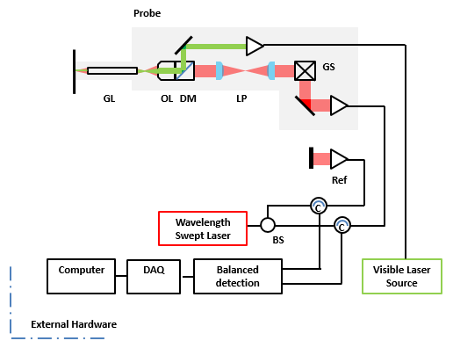
Progress
Figure 2: Proposed schematic. GL: GRIN lens, OL: 10X objective lens, DM: dichroic mirror, SM/GS: Galvano scanning mirror. BS: beam splitter, C: circulator, Ref: reference arm, DAQ: data acquisition. The current schematic preserves the function of simultaneous OCT imaging system and illumination probe.

Slide 14
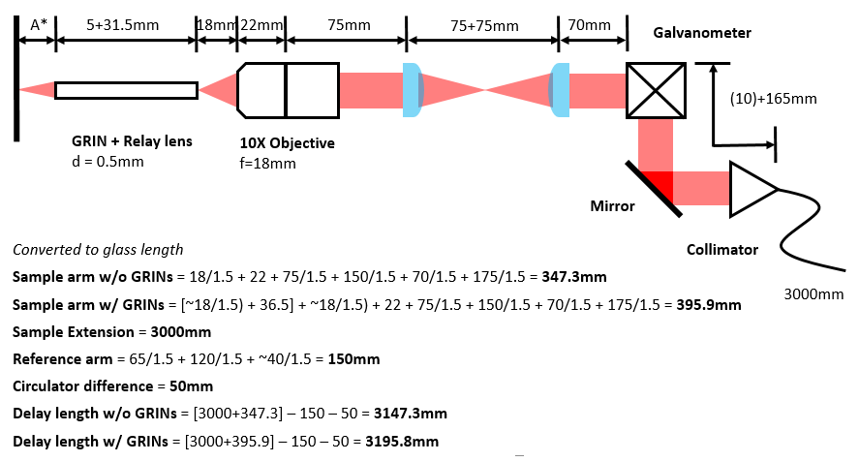
Progress
Figure 3: Calculation of the delay length of the reference arm in order to match the optical path lengths of sample and reference arms for low coherence interference.

Slide 15
Progress
We have first set up the system according to the schematic in Figure 2. Since OCT signal acquisition is based on low coherence interference of light from the sample arm (endoscope) and the reference arm, delay lines were created for both the sample and reference arms such that the total length of each arm was equal.
As shown in Figure 3, the total optical path length was measured for the sample arm with and without the GRIN lens, and compared to the optical path length of the reference arm, so that we can obtain the measurements for the required delay lines. It was apparent that two delay lines were necessary to align this system, once without the GRIN lens followed by with the addition of a GRIN lens. Therefore, using an optical fiber splicer, we created lines of 3147 mm and 3196 mm.

Slide 16
Progress > OCT w/o GRIN
The OCT system without the GRIN lens was assembled, as shown in Figure 4. The images of 10 um microspheres and hand skin were taken to demonstrate the functionality of this system.
However, since our first goal was to test the feasibility of 25 gauge backward scanning, and for the interest of time, this core OCT system has not been characterized and was assumed to be capable of taking quality images.
However, the system efficiency was measured. The power meter placed after each optical component had the following readings: 11.8 mW after the source input, 7.7 mW after the collimator, 7.0 mW after the galvano scanner, 5.4 mW after the lens pair, and 2.1 mW after the objective lens. When compared with the theoretical power loss across each components, this system has a collective efficiency of 27%.

Slide 17
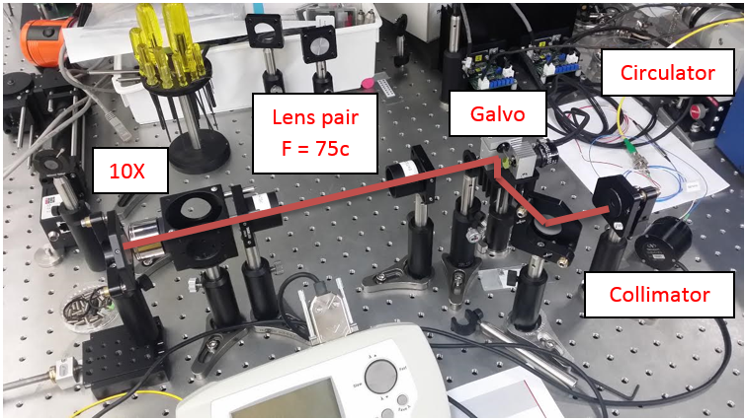
Progress > OCT w/o GRIN
A
B
C
Figure 4: (A) The OCT sample arm as depicted in Figure 2 and Figure 3, without the inclusion of a GRIN lens or dichroic mirror. The red line indicates the path of the OCT beam. At the nose of the sample arm is a mounted mirror used to measure system efficiency. (B) 10 um microsphere embedded in 2% agarose. (C) OCT intensity image of the hand skin.

Slide 18
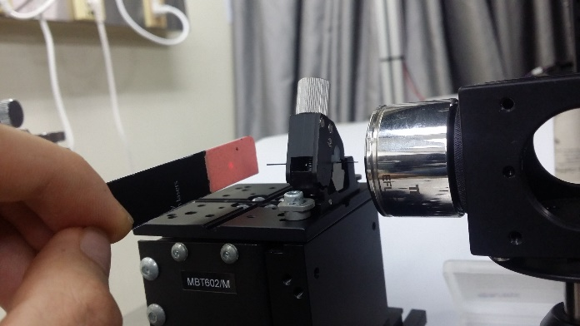


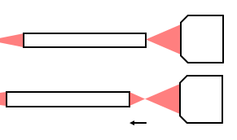
Progress > OCT w/ GRIN
A
B
D
C
Figure 5: The alignment of GRIN lens. (A) The OCT beam was confirmed to pass through the GRIN lens by using an IR card. (B) The center alignment of GRIN lens was determined by enface imaging. (C) A diagram of the direction of GRIN lens displacement to reduce back reflection. (D) A cross sectional image of the GRIN lens that shows the boundaries and the reflection from the back surface of the GRIN lens, which assisted in determining focal point and x-y alignment.

Slide 19
Progress > OCT w/ GRIN
The GRIN lens was then mounted onto a fiber optics holder, as can be seen in Figure 5. With the shorter delay line still in place, the region of coherence interference occurs at the back surface of the GRIN lens. With assistance of OCT enface imaging (Figure 5b) and real-time cross sectional intensity OCT imaging (Figure 5d), the approximate alignment of GRIN lens could be achieved, even though it originally took some time, and using an infrared card, the OCT beam can be seen to pass through the GRIN lens (Figure 5a).
Therefore, to reduce the amount of back reflection, the GRIN lens was displaced forward 0.625 mm such that the back aperture was 0.25 mm in diameter (this also later serves as an issue). With the GRIN lens aligned, displaced, and producing less back reflection, the delay line was switched to the longer one so that the region of coherence interference occurred at the front of the GRIN lens.

Slide 20
Progress > tissue imaging
In addition, the visible laser was set up as demonstrated in Figure 6.
Following, 6 um microsphere were imaged in order to measure the resolution and FOV of the system.
Measuring the full width half maximum of the point spread distribution of microspheres yielded 7 um lateral resolution.
However, the image sampling of 500 pixels across corresponded to a FOV of 754 um, significantly below expectation.
Ex vivo mouse ear was imaged to test the system’s ability to resolved tissue layers, which also performed below expectation (Figure 6c).

Slide 21
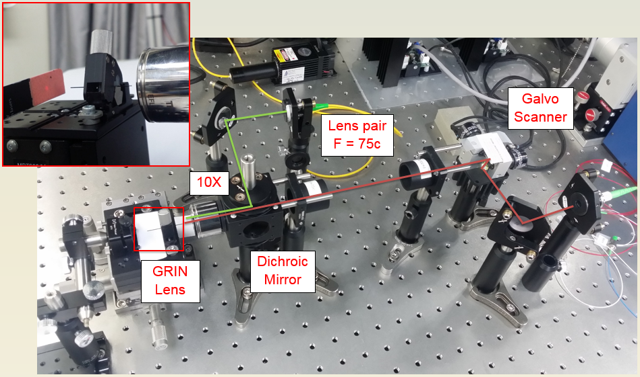
Progress > tissue imaging
A
B
C
Figure 6: (A) The OCT sample arm as depicted in Figure 2 and Figure 3, with the inclusion of the GRIN lens, dichroic mirror, and visible laser. The red line indicates the path of the OCT beam. The green line indicates the path of the visible laser, representing the illumination source. At the nose of the sample arm is a mounted mirror used to measure system efficiency. (B) 6 um microsphere embedded in agarose. (C) OCT intensity image of ex vivo mouse ear.

Slide 22
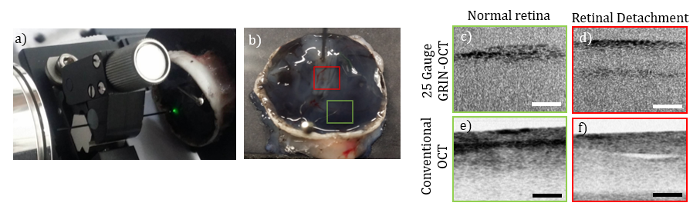
Progress > tissue imaging
Figure 7: (A) Imaging setup of porcine retina with illumination system. (B) imaging locations of the retina: intact retina (red box), retinal detachment (green box). (C, E) Image of intact retina and (D, F) image of retinal detachment, using 25 Gauge GRIN OCT and conventional OCT, respectively. Scale bar: 200 um)

Slide 23
Progress > tissue imaging
Using a power meter, the signal to noise ratio was measured to be 64 dB, which is approximately 20 dB less than the minimum acceptable sensitivity for OCT.
With this in mind, we imaged sites of normal retina and retinal detachment of the excised posterior pole of a porcine eye using our system and conventional OCT. Layers were barely discernable using our system, however there appeared to be some consistency between images taken from both systems.

Slide 24
Discussion
In conclusion, the current setup in not optimal for quality imaging.
Optimization of this system requires revisiting of GRIN lens optics.
The GRIN lens (which currently has an NA of 0.5) must have an NA that equals the NA of the OCT objective lens (0.083). In addition, the conventional method of reducing back reflection is not to displace along the optical axis, but to divert the back reflection away from the pupil by shaving a slanted surface.
Optimal FOV is achieved when the back surface of the GRIN lens receives the focal point. However, by displacing such that the back aperture is 0.25 mm, this diameter gets relayed to the GRIN lens via relay lens, and reduces the focal length since pitch 1.0 relay lens is laterally symmetrical, as depicted in Figure 8.
Therefore, the back end of the relay lens must be reduced by 0.08 pitch to ensure focus at the back surface of the GRIN lens.

Slide 25
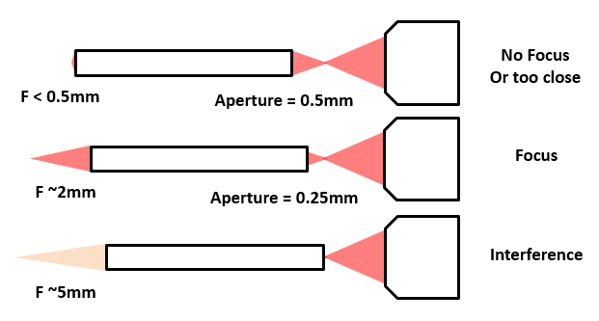
Discussion
Figure 8: Observations regarding the displacement of GRIN lens along the optical axis.

Slide 26
Future Speculation
Finally, in order to produce an optimal illumination system, a Koehler illumination system must be integrated which has not yet been done in this current system.
While we have no been successful in completing a handheld OCT probe, as according to our original proposal, we suggest a concept for miniaturizing our current system after it has been optimized. The needle diameter would be 0.5 mm, encased in protection for integrity. In addition, the GRIN lens holder should be approximately 10 cm, and would weight no more than a computer mouse. The rate limiting step of this production would be the customization of the objective lens and MEMs scanner. The design of the handheld probe is patentable, however the optics technique itself is not.

Slide 27
Conclusion
We have investigated the feasibility of backward scanning OCT through 0.5 mm diameter GRIN lens and thus developed a 25-gauge backward scanning OCT probe capable of producing cross section images of ex vivo pig retina. Further investigation of the optical system is required to produce optimal images. In addition, investigation of component customizability is required to complete the assembly of a handheld probe that satisfied clinical specifications.

Slide 28
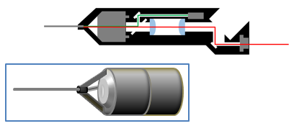
Future Speculation
Figure 8: Concept design of handheld probe with removable GRIN lens holder.

Slide 29
References
1. Joos KM, Shen JH. Miniature real-time intraoperative forward-imaging optical coherence tomography probe. Biomed Opt Exp. 2013 Aug;4(8):1342-1350.
2. Leitgeb N, Schuy S, Zirm M. Ultrasonic vitrectomy – an alternative technique to presently used mechanical procedures. Experimental results. Albrecht Von Graefes Arch Klin Exp Ophthalmol. 1979 Feb 8;209(4):263-8.
3. Marra, KV, Yonekawa Y, Arroyo J. Indications and Techniques of Endoscope Assisted Vitrectomy. J Ophthalmic Vis Res. 2013 July;8(3):282-290.
4. Han S, Sarunic MV, Wu J, et al. Handheld forward-imaging needle endoscope for ophthalmic optical coherence tomography inspection. J Biomed Opt. 2008 Mar-Apr;13(2):020505.
5. Warrier SK, Jain R, et al. Sutureless vitrectomy. Indian J Ophthalmol. 2008 Nov-Dec;56(6):453-458.
6. Liu X, Cobb MJ, Chen Y. Rapid-scanning forward-imaging miniature endoscope for real-time optical coherence tomography. Optics Letters. 2004 Aug;29(15):1763-1765.
7. Huang Y, Liu X, Song C, Kang JU. Motion-compensated hand-held common-path Fourier-domain optical coherence tomography probe for image-guided intervention. Biomed Opt Exp. 2012 Dec;3(12):3105-3118.

Slide 30
Appendix

Slide 31
Proposal > Task #1
Development of miniaturized OCT integrated with illumination.
[X] Optical design based on endoscopic OCT and visible illumination.
[X] Relay lenses paired with GRIN lens to compensate for insufficient length of GRIN lens.
[X] Achieve 25 gauge probe dimension.
[X] Include dichroic mirror which transmits OCT laser and reflects visible light in order to achieve simultaneous illumination and high depth-of-focus 3D OCT imaging.
[X] Match the difference between optical path sample and reference by adding a delay unit within the coherence length of the light.
[X] Compensate the dispersion due to optical element.
[ ] Development of wide-viewing lens based on 10x magnifying GRIN lens to obtain a field of view of 4mm and effective NA of 0.01
Note: 4mm FOV not yet achieved. However, may be possible. Refer to Appendix.

Slide 32
Proposal > Task #2
2. Characterization of lateral resolution and imaging depth using 10um diameter microsphere, followed by characterization with tissue samples.
[X] Use point spread function and Gaussian fit to measure the lateral resolution.
[ ] Measure the system sensitivity, preferably greater than 85dB.
[X] Imaging of ex vivo normal tissue and ex vivo affected tissue using cow eye.
[ ] Comparison of measured depth-of-focus with theoretical values.
[ ] Other animal model experiments will be conducted in Asan Medical Center.
Note: Besides conducting animal model experiments, all else will be possible to achieve within a few days.

Slide 33
Proposal > Task #3
3. Optimize design according to clinical or surgical specifications .
[ ] Handheld probe designed for flexible positioning.
[ ] Specifications: probe diameter (0.5-0.8mm), needle length (5cm), handle length (10cm)
[ ] Weight: light enough to be carried by the hand for several hours without physical strain.
[ ] Create user-friendly GUI for controlling OCT.
Note: I will include a proposed design of this probe using Solidworks and proposed specifications of optical components.

Slide 34
Figure 1a. System Schematic
Probe
GS
GL
OL
DM
LP
Ref
C
Wavelength Swept Laser
C
BS
Computer
DAQ
Balanced
detection
Visible Laser
Source
External Hardware
Notes:
GRIN Lens
d=0.5mm, l=5mm, p=1.19, M=-1 : 11.32, i=1.635, PN: GT-IFRL-050-005-50-CC
Relay Lens:
0.5 - 1.0 0.5 like Design A ca. 31.5mm without eyepiece
NA = beam diameter/focal length

